Slide 1
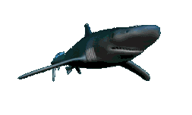

Sharks! Friends or Foe?
A multi-level learning and evaluation situation
RCCPALS
Regroupement des Conseillères et Conseillers
Pédagogiques Anglais Langue Seconde

Slide 2
Based on the LES for Secondary One
Sharks! Good, Bad or Scary?
Original evaluation situation:
Gwenn Gauthier
Jo-Lynn Gauthier
With the collaboration of Rachel Lalonde
Updated version:
Gwenn Gauthier
François Hudon
Multi-level version:
Cynthia Beyea
Steven Jansma
Karen Lyons
RCCPALS
Regroupement des Conseillères et Conseillers
Pédagogiques Anglais Langue Seconde

Slide 3
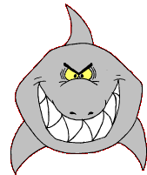
Three differentiated levels for teenaged learners:
Primary Cycle Two
Primary Cycle Three
Secondary Cycle One

Slide 4
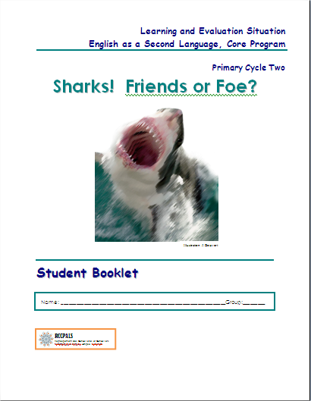
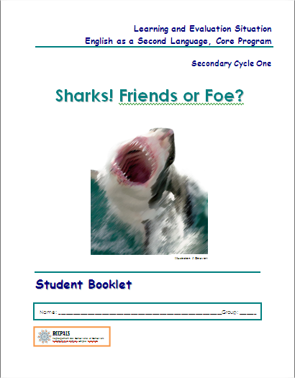
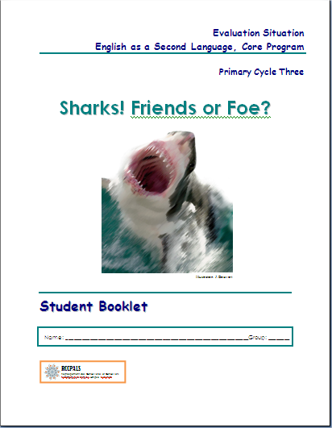
Comprised of:
  Common Teacher’s Guide
  Student Booklet (three versions)
  Reading Booklet (three versions)

Slide 5
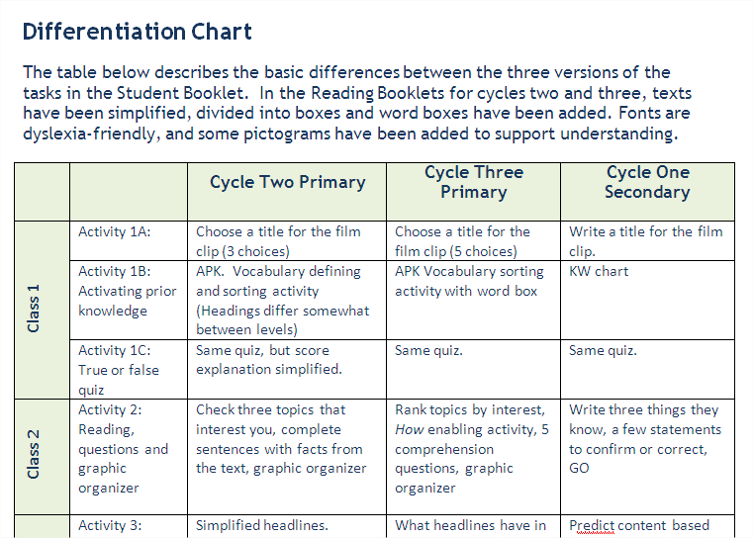
Differentiation Chart

Slide 6
Other adaptations
Dyslexia-friendly font (comic sans serif)
Page and paragraph organization: use of text boxes and borders
Word boxes added for key words
Pictograms for some words
Simplified task instructions
Teaching Tips in teacher’s guide (suggested strategies)

Slide 7
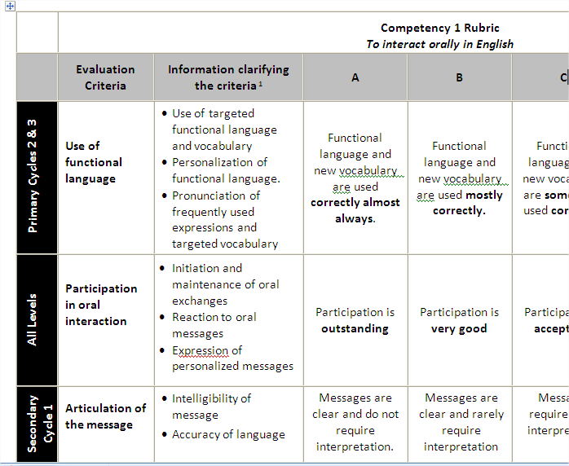
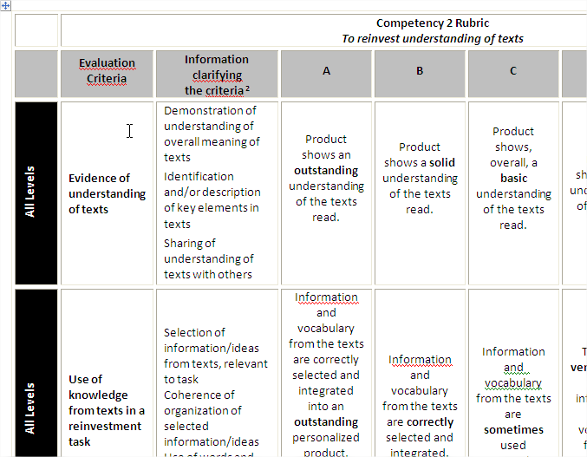
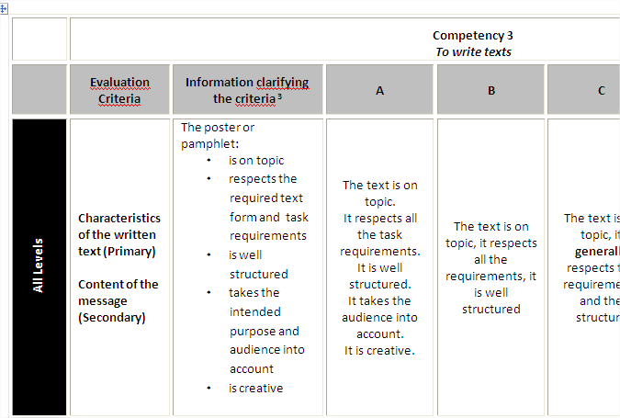
Multi-level Rubrics

